Slide 1
NHANES 2011–2016: Heavy Metal Exposure and
Disability
Machine Learning Model Comparison
Santhakumar Ramesh · University at Buffalo · October 2025
Comprehensive Model Comparison Presentation
Slide 1 of 49

Slide 2
Motivation
Even low-to-moderate exposure to heavy metals like lead and cadmium can impair
physical functioning. We study how metal biomarkers measured in NHANES
are associated with disability in U.S. adults.
Slide 2 of 49

Slide 3
Dataset Overview
• NHANES 2011–2016 (Cycles G, H, I) • Outcome: any_disability (derived from PFQ items) • N=8,956; Modeling sample=7,701; Prevalence≈16.1% • Features: 5 metal biomarkers (Lead, Cadmium, Mercury, Manganese, Selenium)
+ 2 Demographicz (Age , BMI)
Slide 3 of 49

Slide 4
Modeling Pipeline
Data cleaning →
Feature engineering →
Train/Test split →
Train 5 models (Logistic, RF, RF-Cal, XGB, XGB-Cal) →
Evaluate with ROC AUC, PR-AUC, Sensitivity, Specificity, Brier, Calibration →
Interpret feature effects & exposure risk.
Slide 4 of 49

Slide 5
Model 1 – Logistic Regression
Strong baseline with AUC≈0.77. Odds ratios highlight cadmium as a major risk factor;
calibration is acceptable and probabilities are informative.
Slide 5 of 49

Slide 6
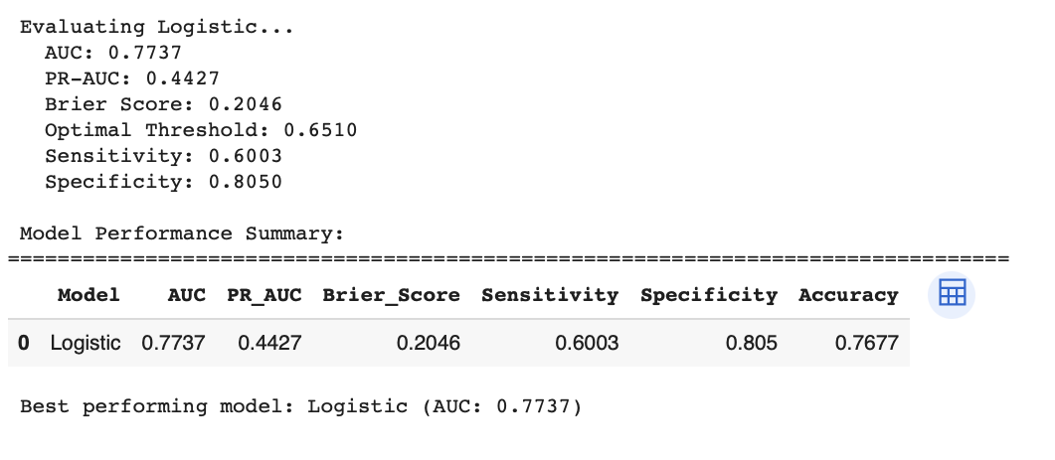
Interpretation: This figure illustrates the model's behavior. Consider the trade-offs between sensitivity and
specificity, and how calibration affects probability reliability.
Slide 10 of 49

Slide 7
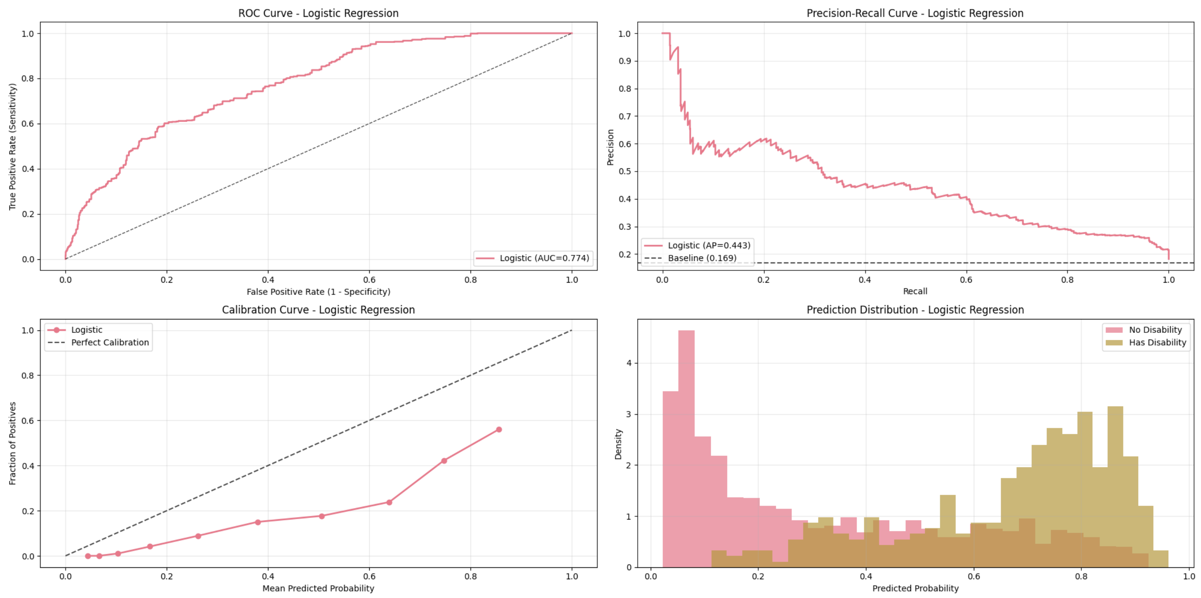
Interpretation: This figure illustrates the model's behavior. Consider the trade-offs between sensitivity and
specificity, and how calibration affects probability reliability.
Slide 6 of 49

Slide 8
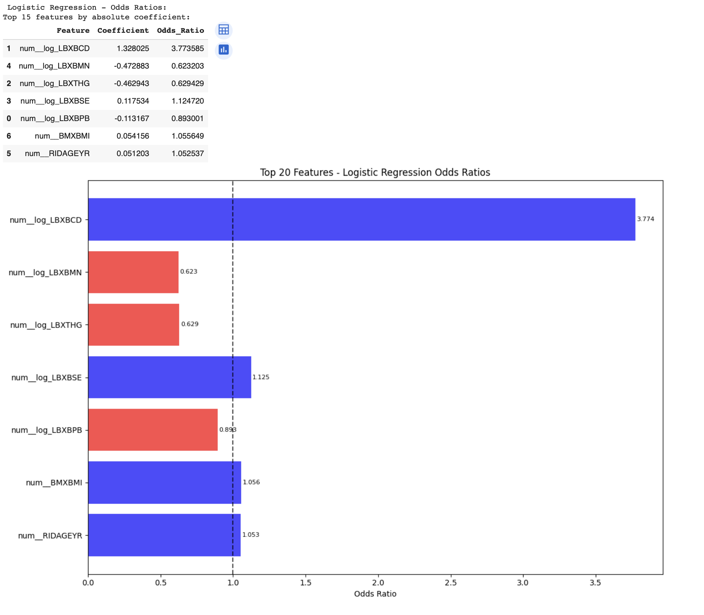
Interpretation: This figure illustrates the model's behavior. Consider the trade-offs between sensitivity and
specificity, and how calibration affects probability reliability.
Slide 7of 49

Slide 9
Model 2 – Random Forest
Captures nonlinearities and interactions, improving sensitivity. Feature importance confirms
Age, BMI, and Cadmium as dominant predictors.
Slide 11 of 49

Slide 10
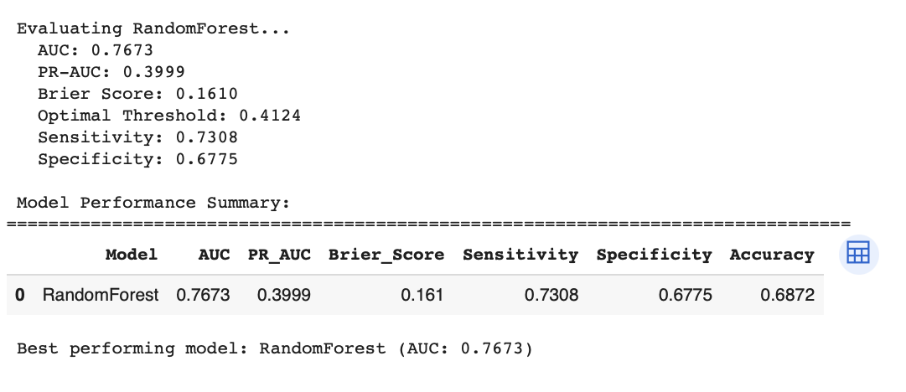
Interpretation: This figure illustrates the model's behavior. Consider the trade-offs between sensitivity and
specificity, and how calibration affects probability reliability.
Slide 12 of 49

Slide 11
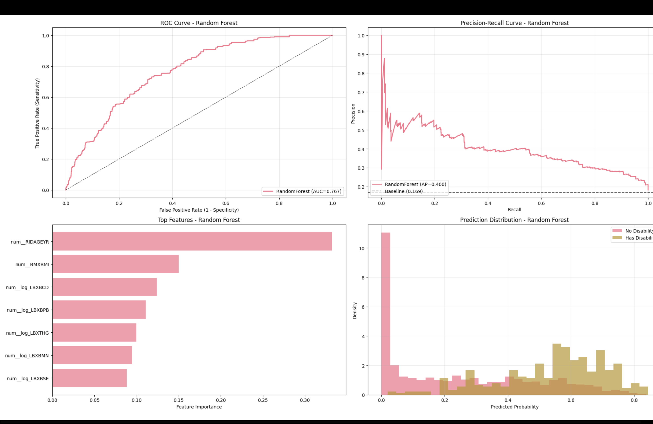
Interpretation: This figure illustrates the model's behavior. Consider the trade-offs between sensitivity and
specificity, and how calibration affects probability reliability.
Slide 13 of 49

Slide 12
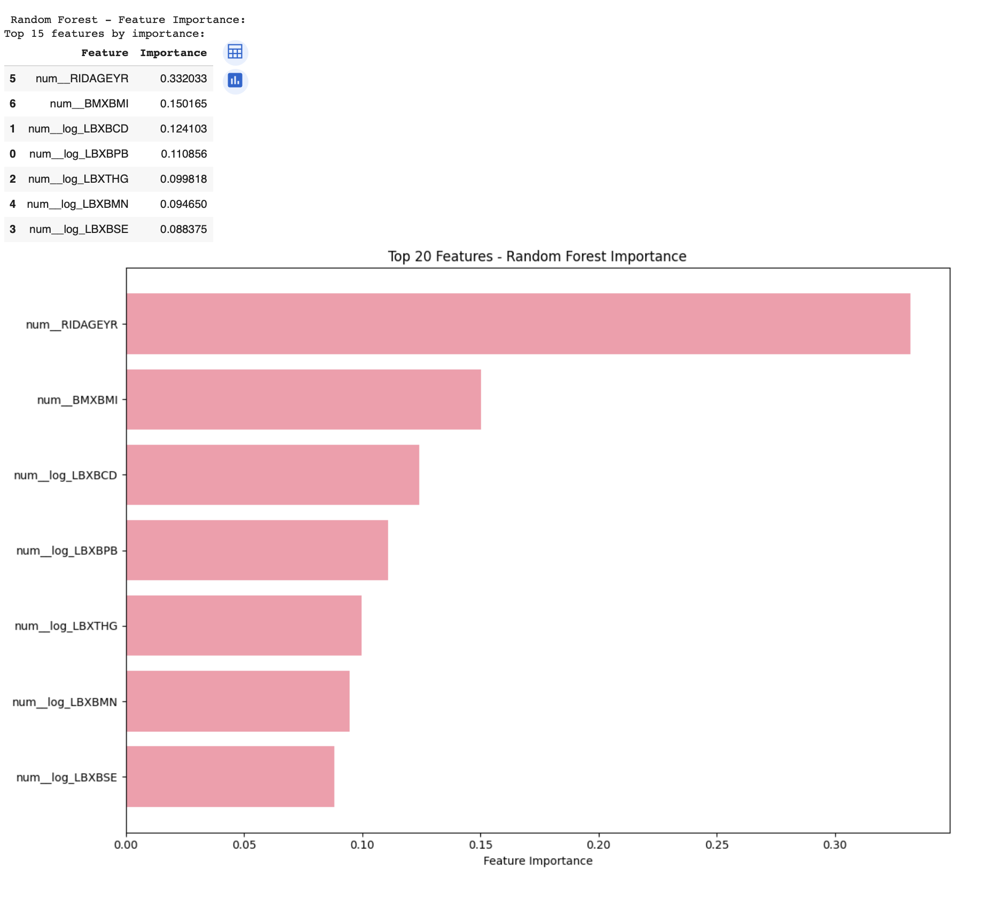
Interpretation: This figure illustrates the model's behavior. Consider the trade-offs between sensitivity and specificity,
and how calibration affects probability reliability.
Slide 15 of 49

Slide 13
Model 3 – Random Forest (Calibrated)
Calibration aligns probabilities with outcomes (lower Brier). Discrimination remains high;
key predictors are stable, strengthening trust in outputs.
Slide 17 of 49

Slide 14
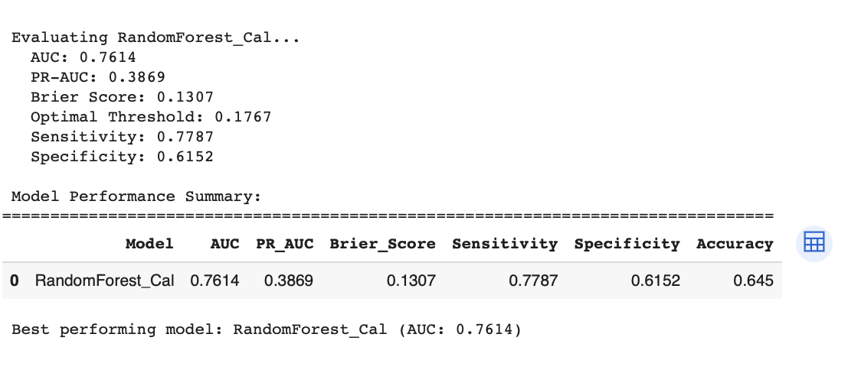
Interpretation: This figure illustrates the model's behavior. Consider the trade-offs between sensitivity and
specificity, and how calibration affects probability reliability.
Slide 12 of 49

Slide 15
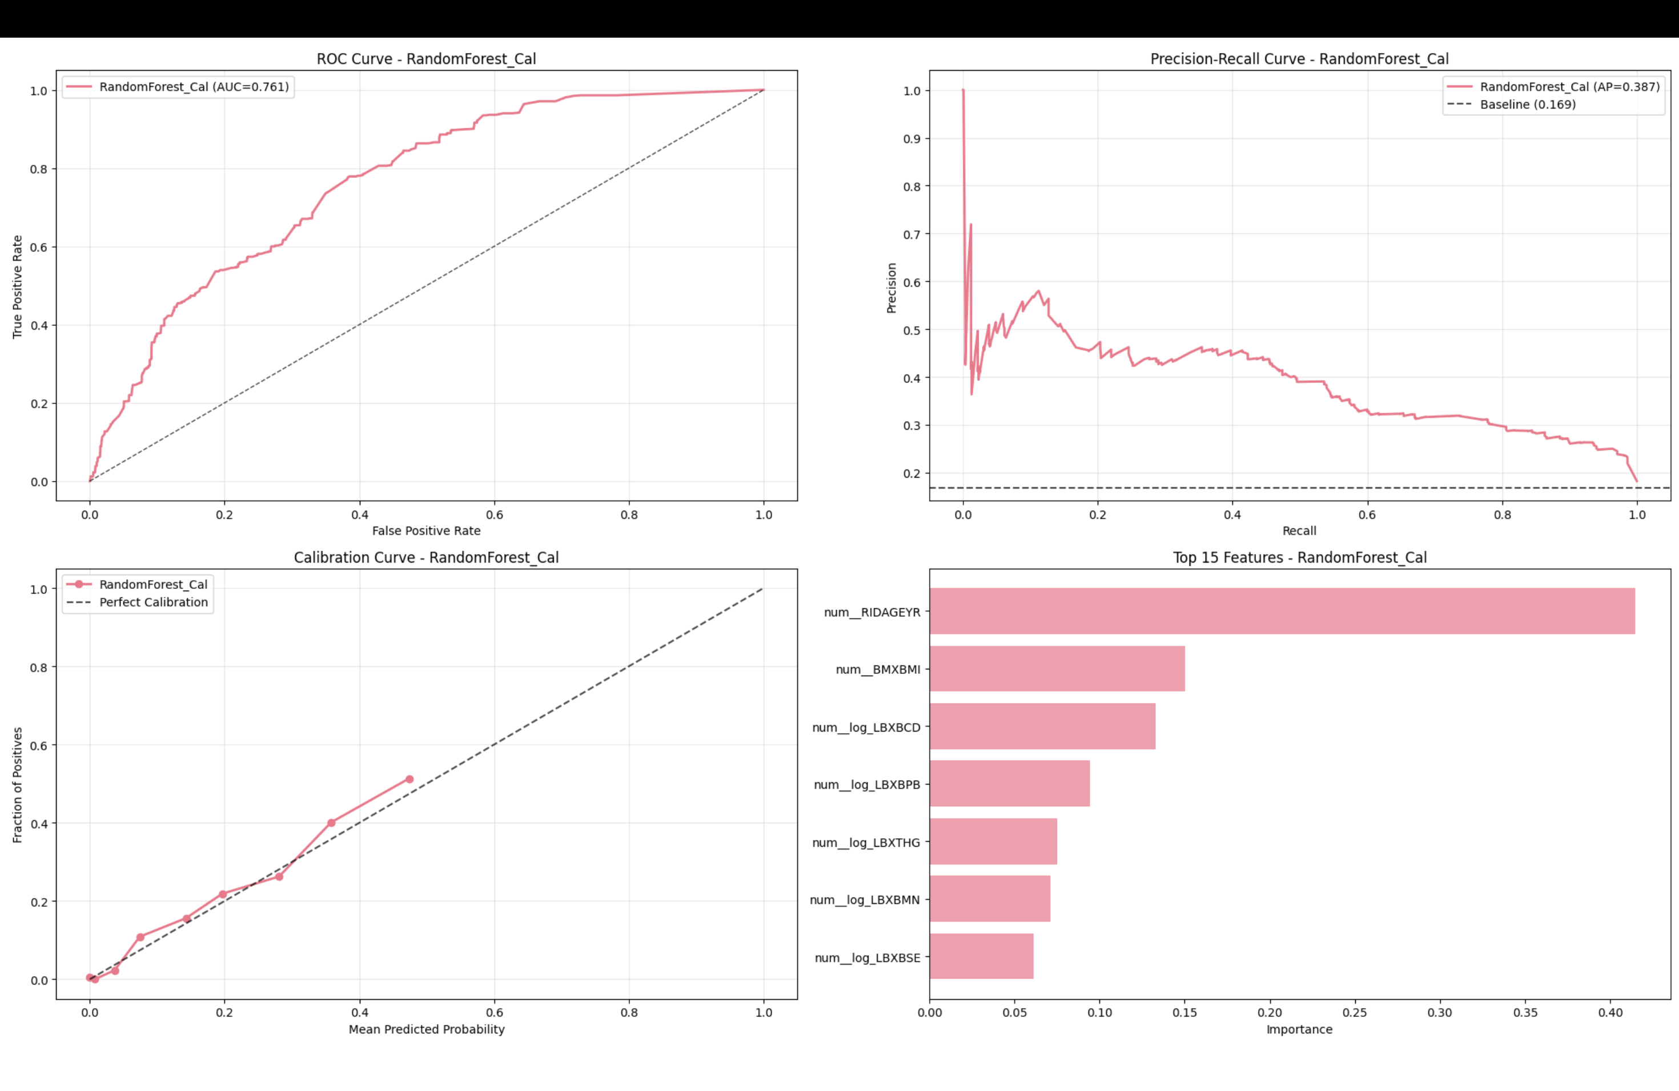
Interpretation: This figure illustrates the model's behavior. Consider the trade-offs between sensitivity and
specificity, and how calibration affects probability reliability.
Slide 13 of 49

Slide 16
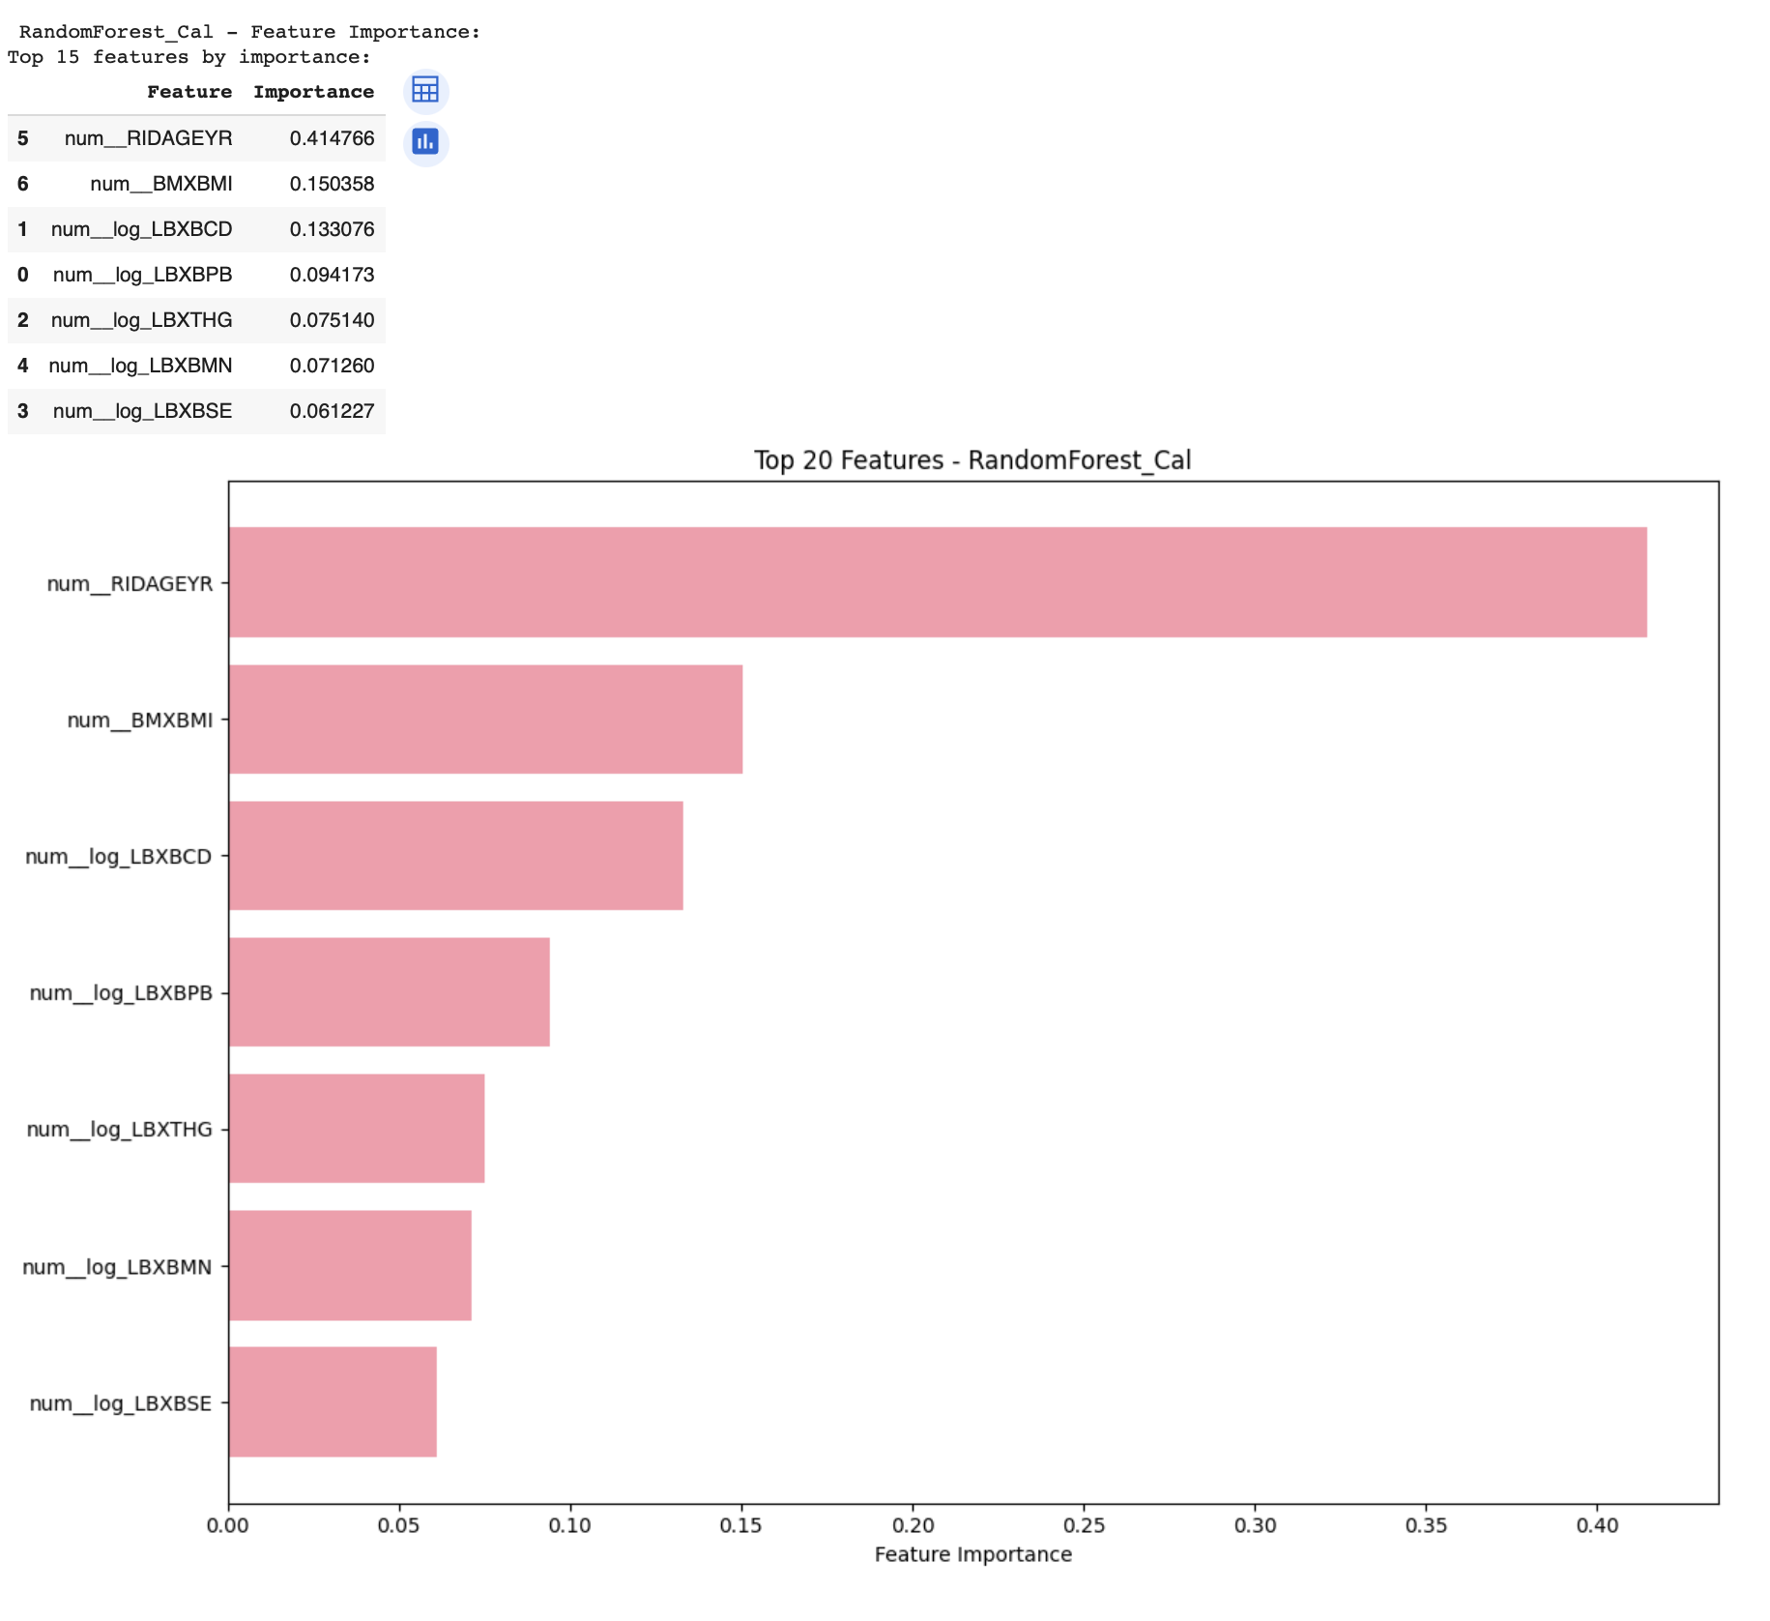
Interpretation: This figure illustrates the model's behavior. Consider the trade-offs between sensitivity and specificity,
and how calibration affects probability reliability.
Slide 15 of 49

Slide 17
Model 4 – XGBoost
Balances discrimination with complex relationships. Importance mirrors other models;
quartile plots reveal dose–response patterns (e.g., Lead).
Slide 18 of 49

Slide 18
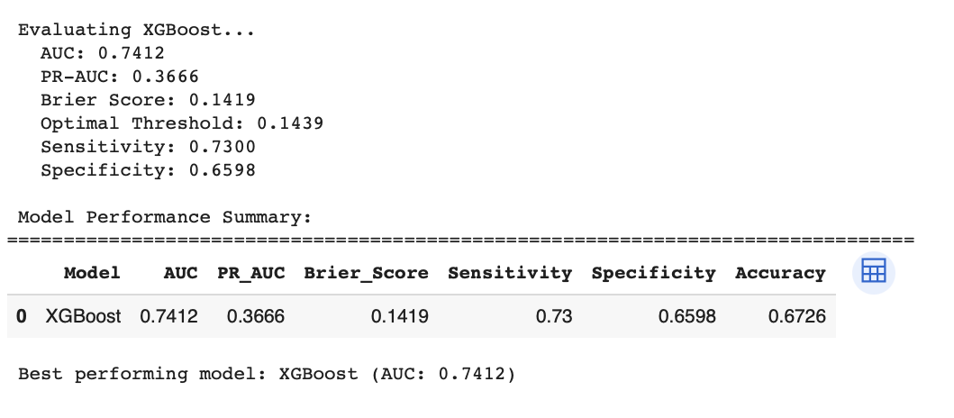
Interpretation: This figure illustrates the model's behavior. Consider the trade-offs between sensitivity and specificity,
and how calibration affects probability reliability.
Slide 19 of 49

Slide 19
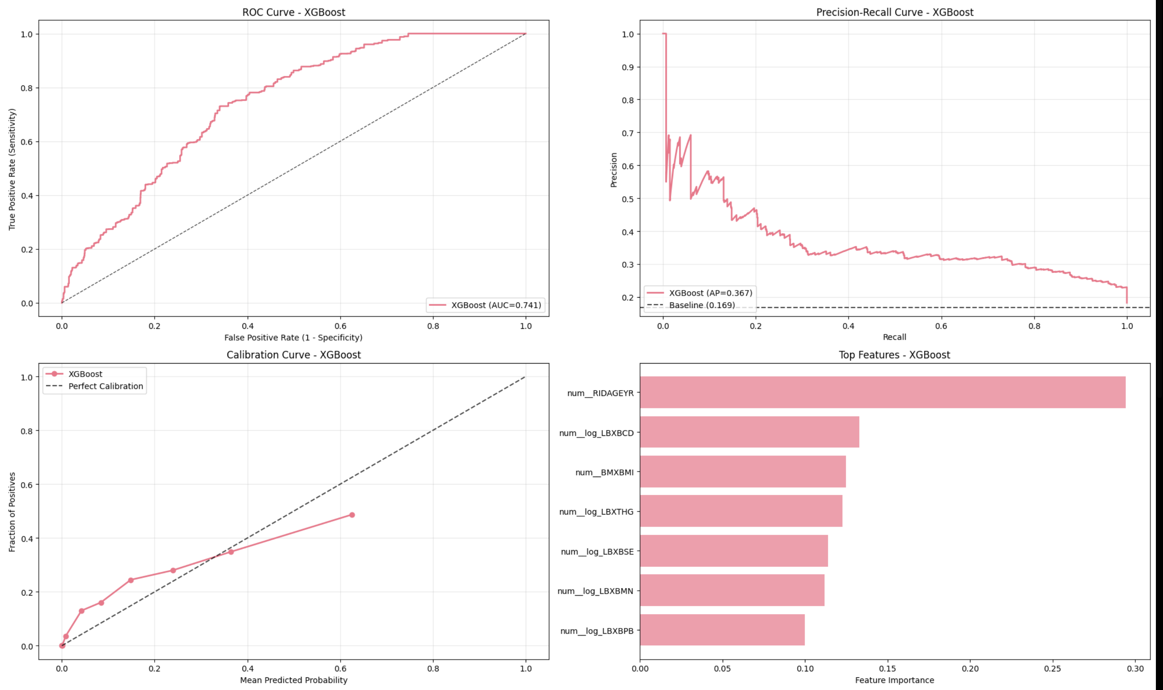
Interpretation: This figure illustrates the model's behavior. Consider the trade-offs between sensitivity and specificity,
and how calibration affects probability reliability.
Slide 20 of 49

Slide 20
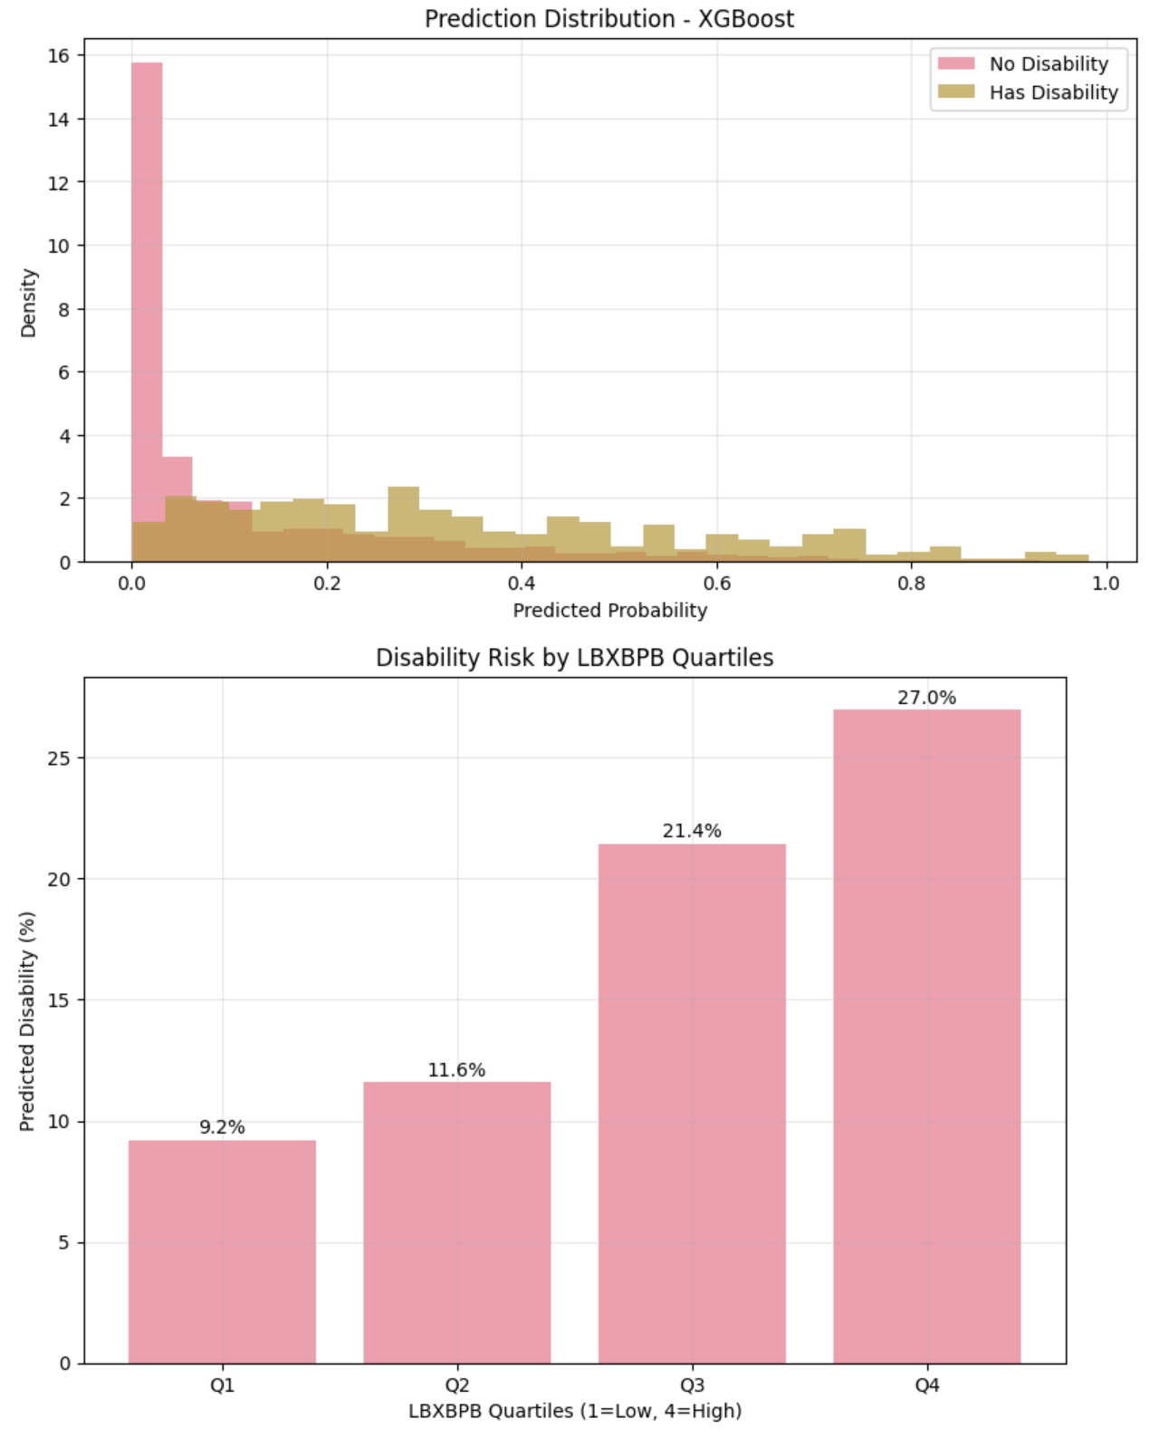
Interpretation: This figure illustrates the model's behavior. Consider the trade-offs between sensitivity and specificity,
and how calibration affects probability reliability.
Slide 22 of 49

Slide 21
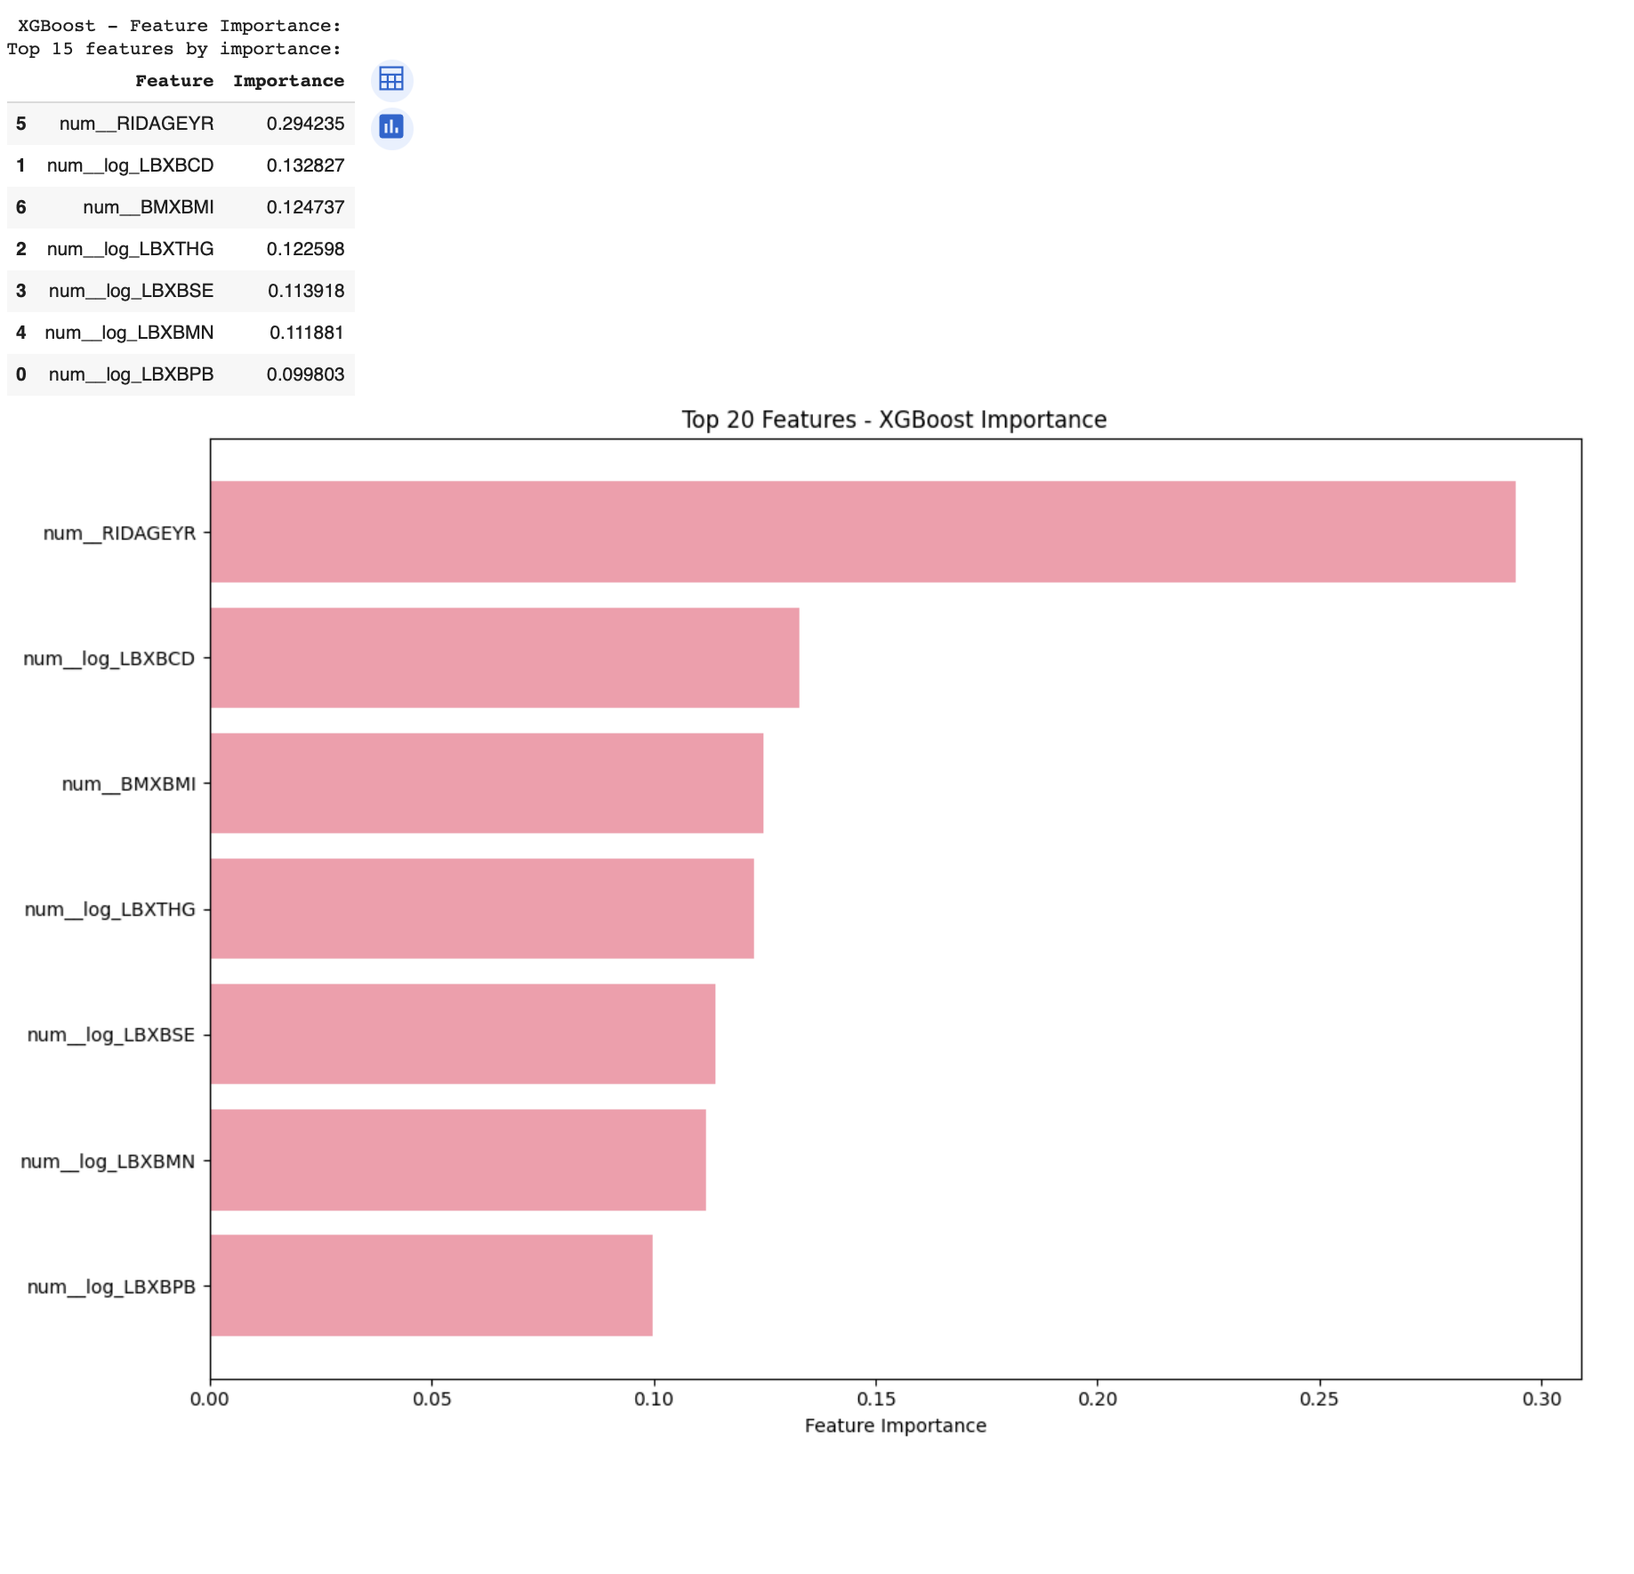
Interpretation: This figure illustrates the model's behavior. Consider the trade-offs between sensitivity and specificity,
and how calibration affects probability reliability.
Slide 15 of 49

Slide 22
Model 5 – XGBoost (Calibrated)
Calibration improves reliability and often recall. Curves align well; exposure effects remai
n interpretable.
Slide 26 of 49

Slide 23
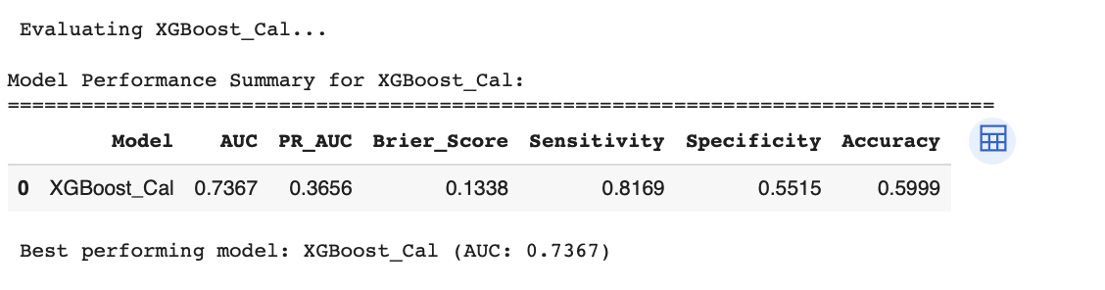
Interpretation: This figure illustrates the model's behavior. Consider the trade-offs between sensitivity and specificity,
and how calibration affects probability reliability.
Slide 27 of 49

Slide 24
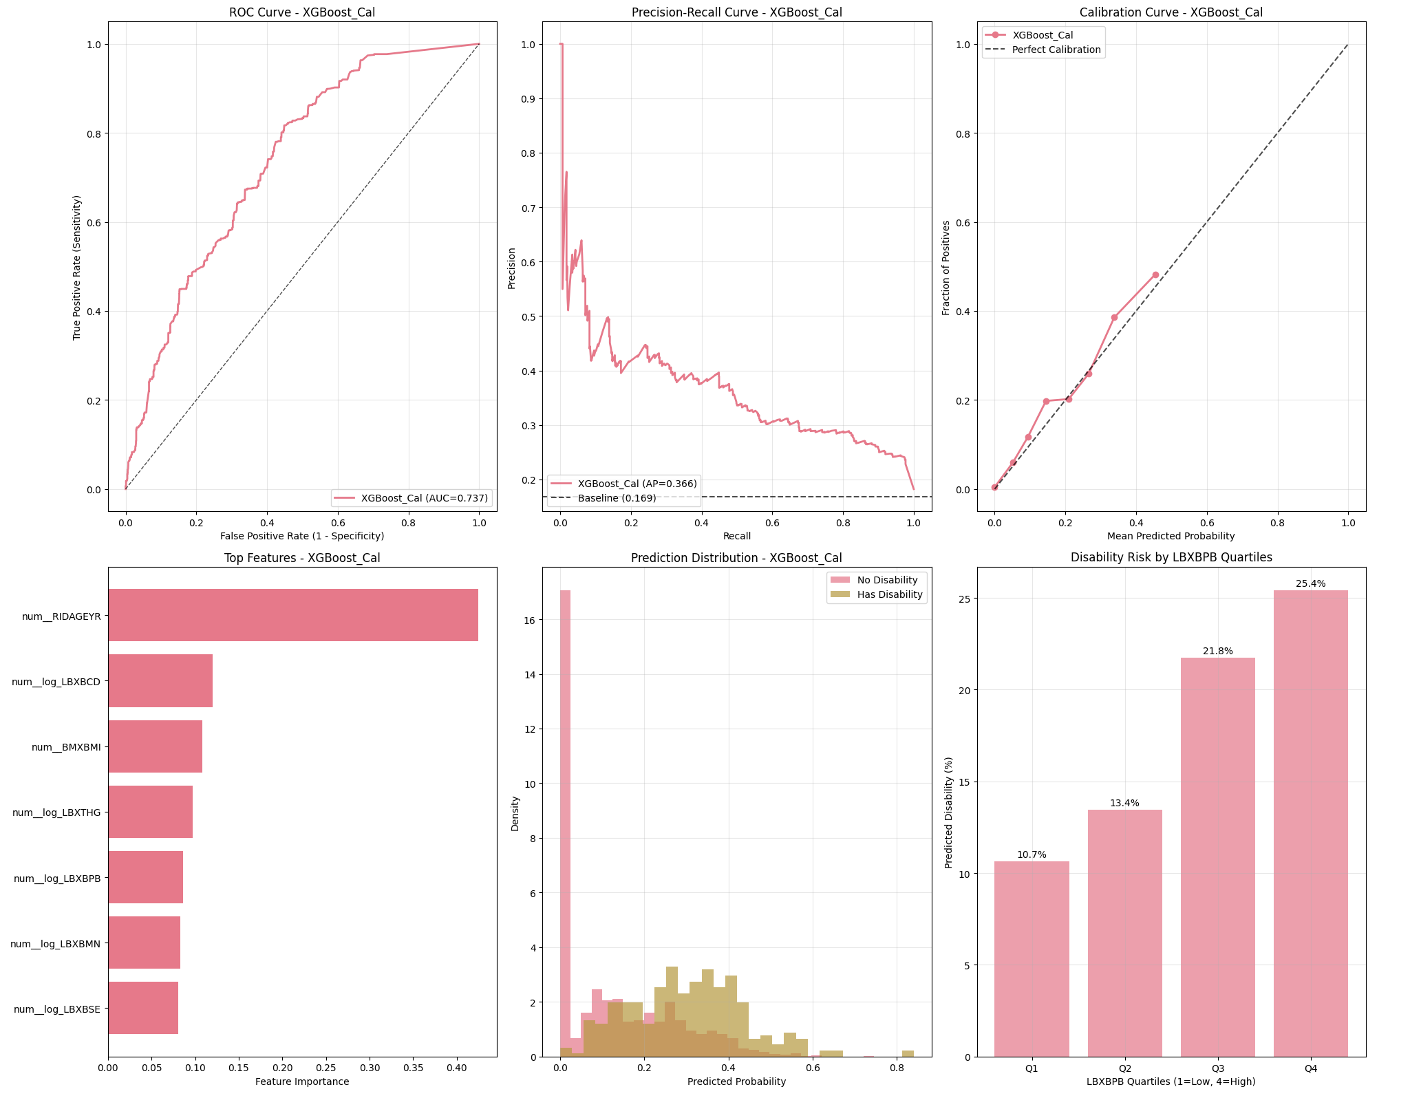
Interpretation: This figure illustrates the model's behavior. Consider the trade-offs between sensitivity and specificity,
and how calibration affects probability reliability.
Slide 28 of 49

Slide 25
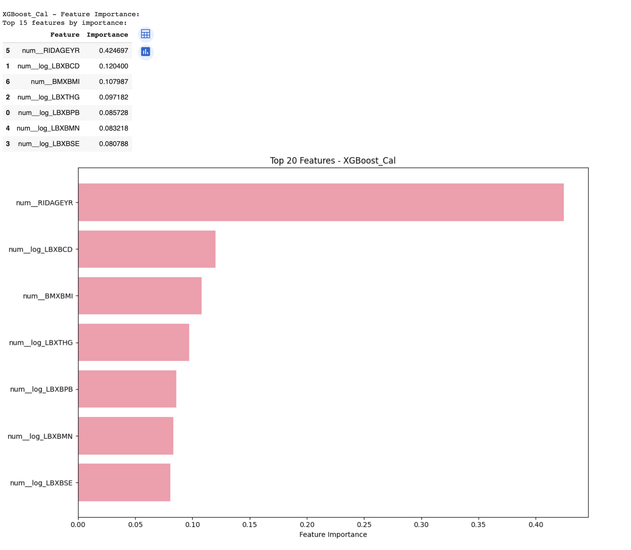
Interpretation: This figure illustrates the model's behavior. Consider the trade-offs between sensitivity and specificity,
and how calibration affects probability reliability.
Slide 15 of 49

Slide 26
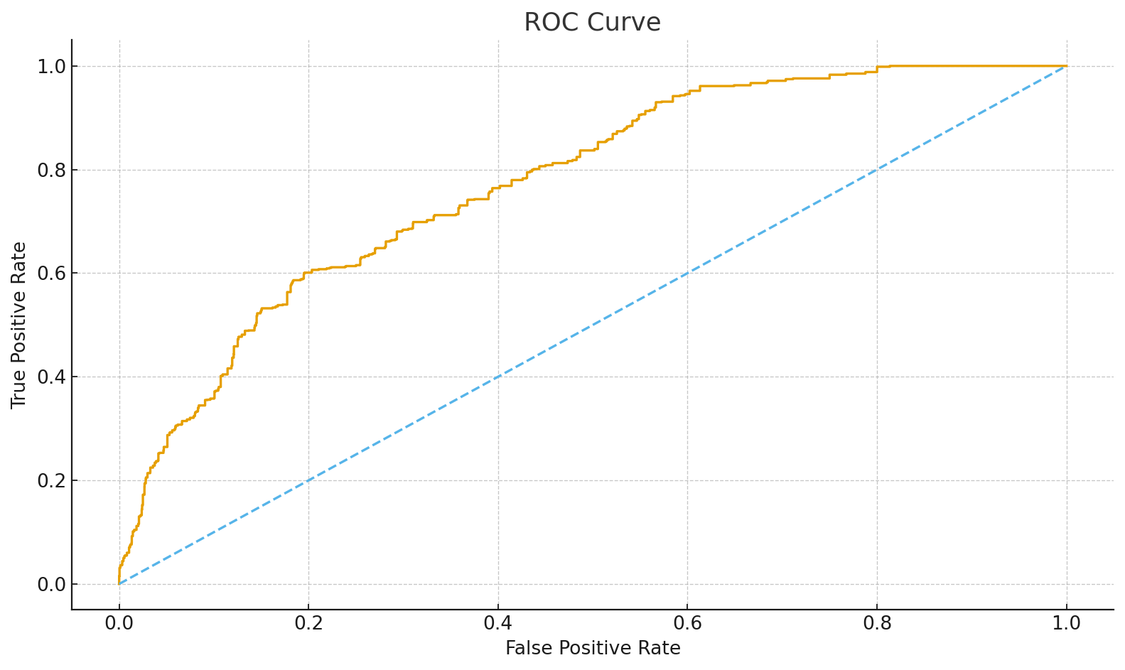
Model 1 – Logistic: ROC Curve
Higher curves indicate better discrimination. The diagonal is chance; AUC summarizes separability.
Slide 32 of 49

Slide 27
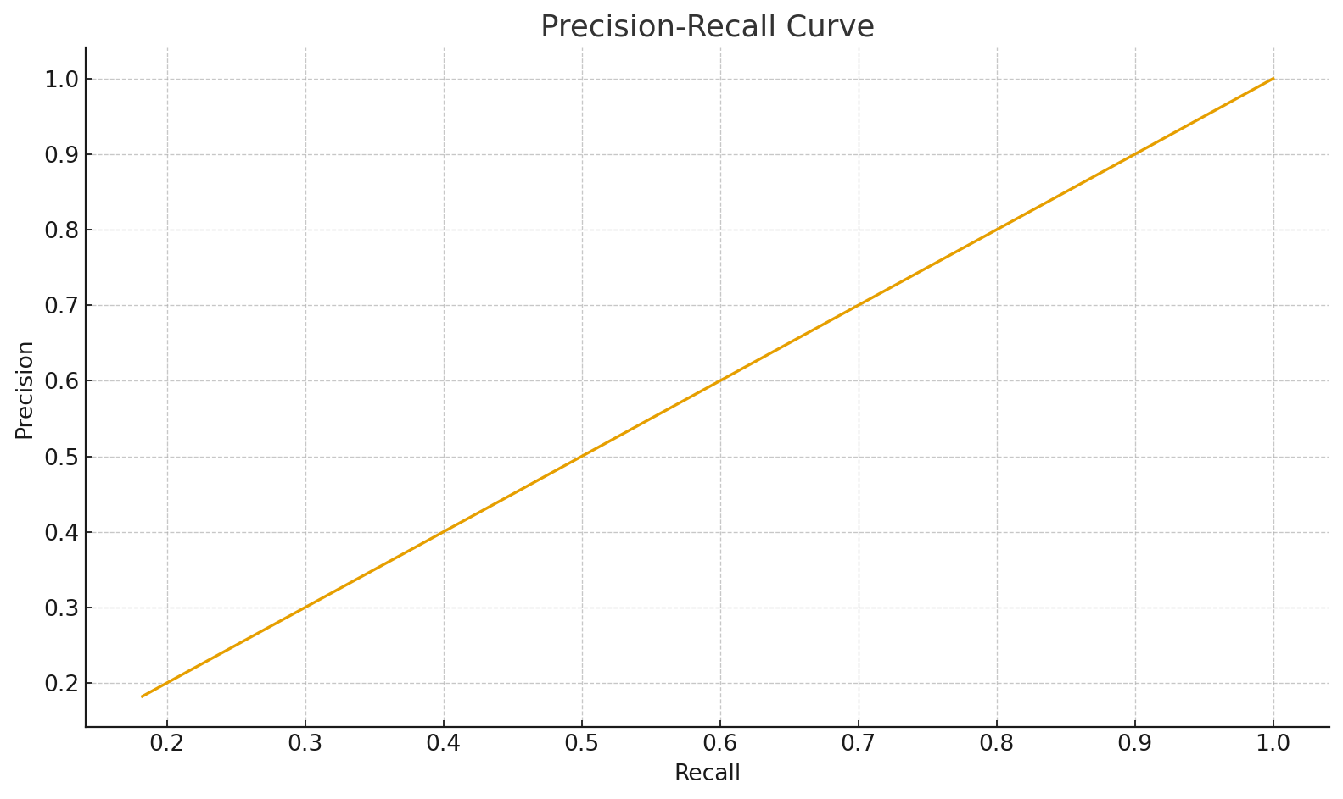
Model 1 – Logistic: Precision–Recall Curve
For imbalanced data, PR highlights positive-class performance: precision (purity) vs recall (coverage).
Slide 33 of 49

Slide 28
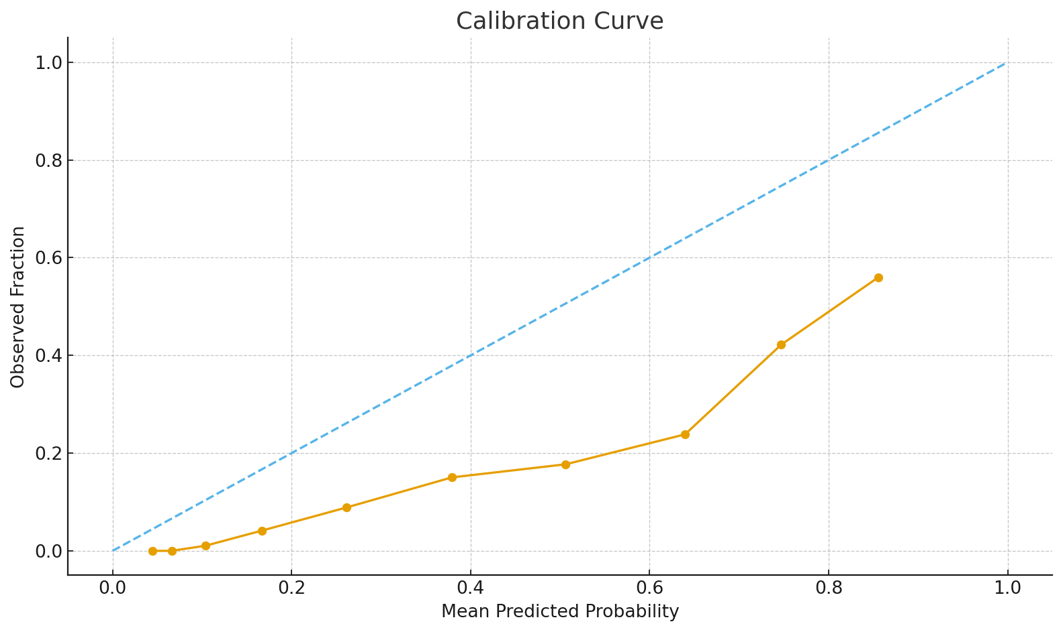
Model 1 – Logistic: Calibration Curve
Points near the diagonal indicate well-calibrated probabilities that match observed outcomes.
Slide 34 of 49

Slide 29

Model 2 – RF: ROC Curve
Higher curves indicate better discrimination. The diagonal is chance; AUC summarizes separability.
Slide 35 of 49

Slide 30
Model 2 – RF: Precision–Recall Curve
For imbalanced data, PR highlights positive-class performance: precision (purity) vs recall (coverage).
Slide 36 of 49

Slide 31
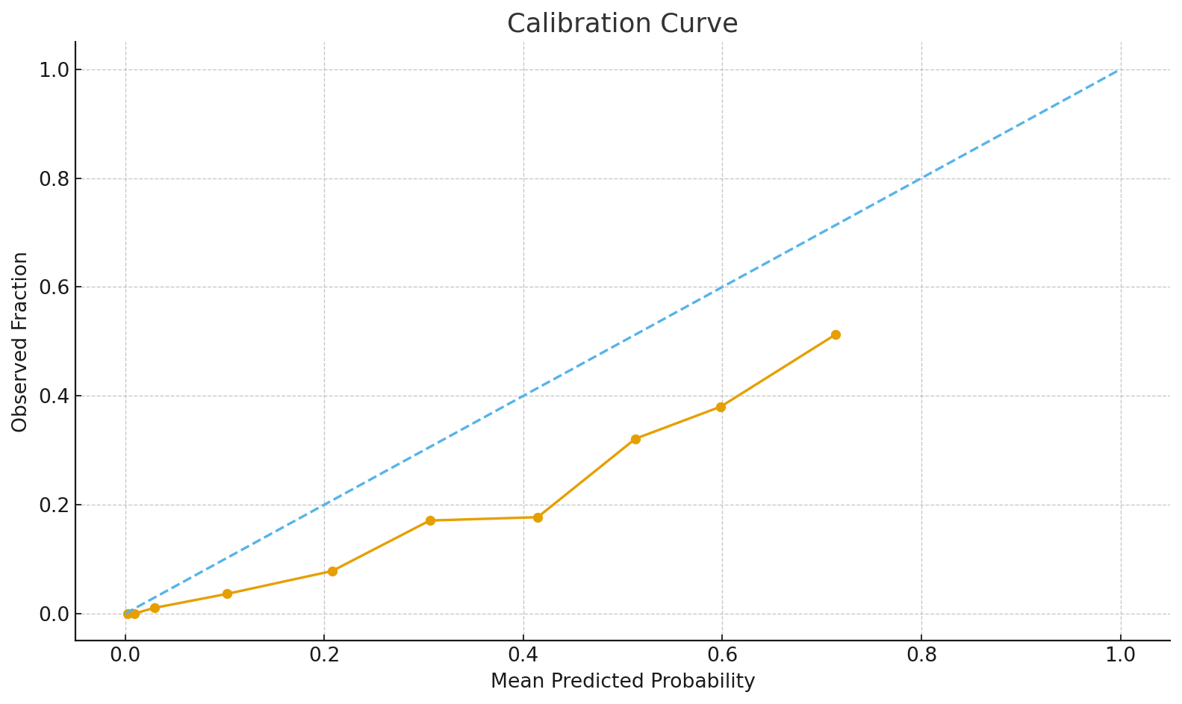
Model 2 – RF: Calibration Curve
Points near the diagonal indicate well-calibrated probabilities that match observed outcomes.
Slide 37 of 49

Slide 32

Model 3 – RF-Cal: ROC Curve
Higher curves indicate better discrimination. The diagonal is chance; AUC summarizes separability.
Slide 38 of 49

Slide 33
Model 3 – RF-Cal: Precision–Recall Curve
For imbalanced data, PR highlights positive-class performance: precision (purity) vs recall (coverage).
Slide 39 of 49

Slide 34
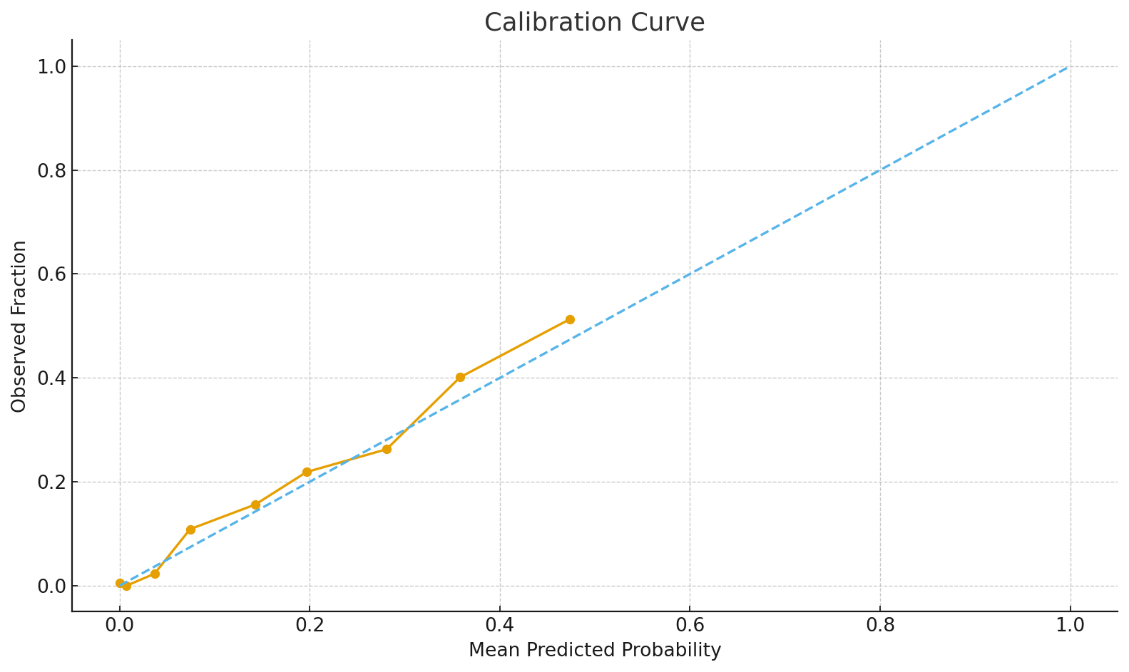
Model 3 – RF-Cal: Calibration Curve
Points near the diagonal indicate well-calibrated probabilities that match observed outcomes.
Slide 40 of 49

Slide 35
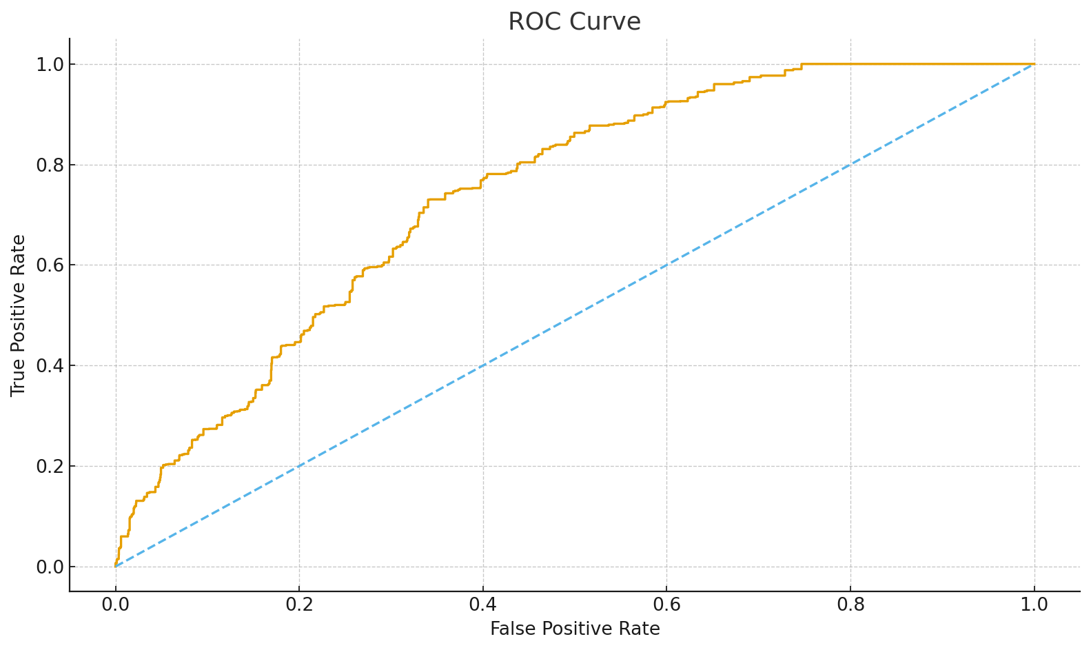
Model 4 – XGB: ROC Curve
Higher curves indicate better discrimination. The diagonal is chance; AUC summarizes separability.
Slide 41 of 49

Slide 36
Model 4 – XGB: Precision–Recall Curve
For imbalanced data, PR highlights positive-class performance: precision (purity) vs recall (coverage).
Slide 42 of 49

Slide 37
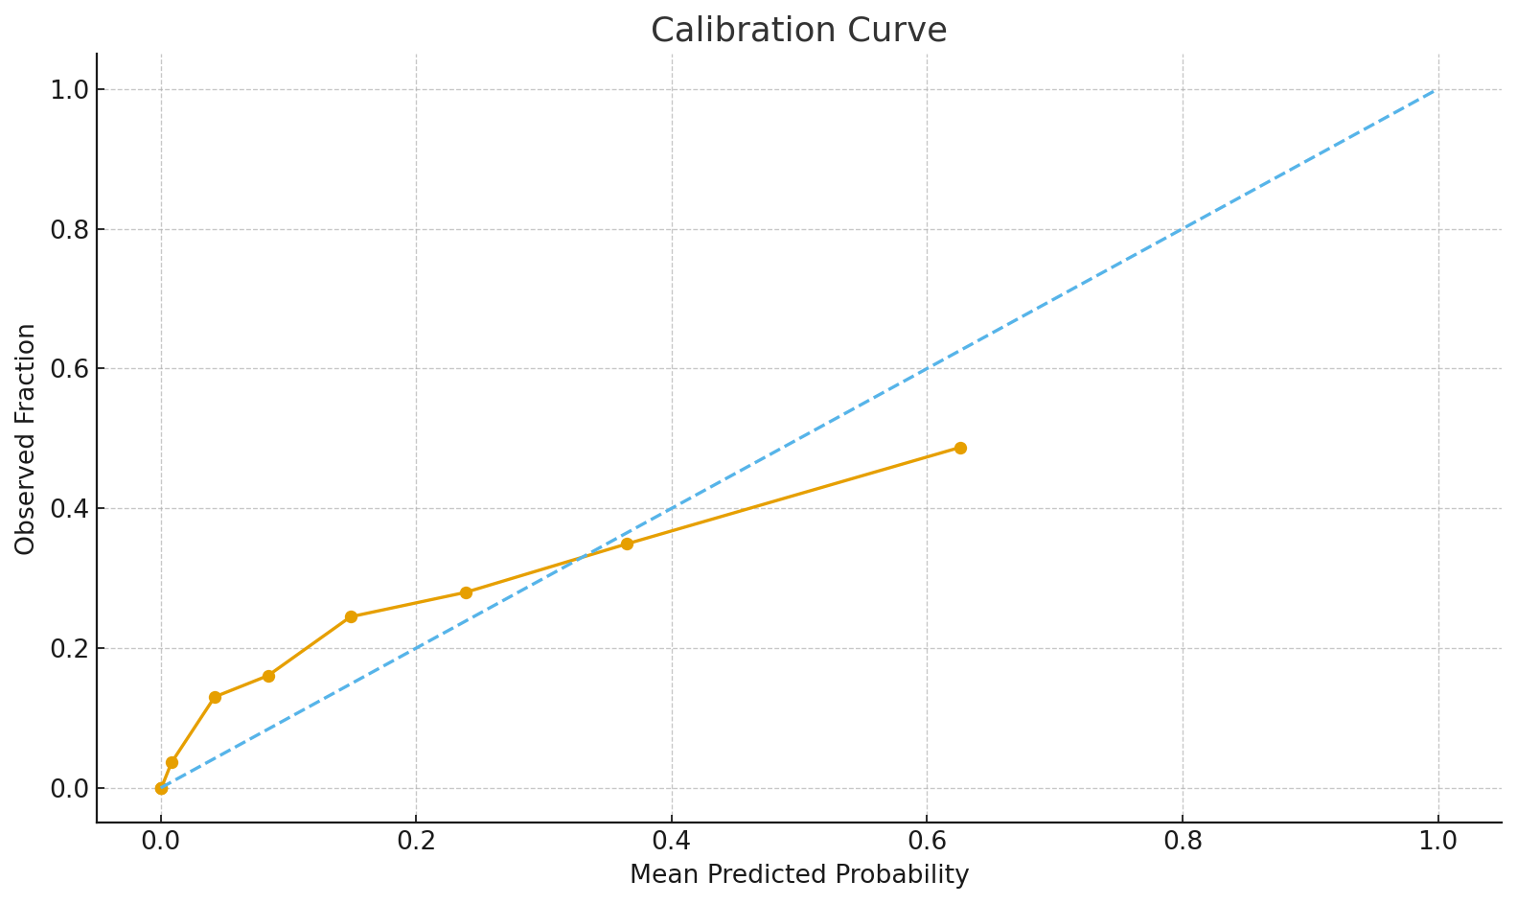
Model 4 – XGB: Calibration Curve
Points near the diagonal indicate well-calibrated probabilities that match observed outcomes.
Slide 43 of 49

Slide 38
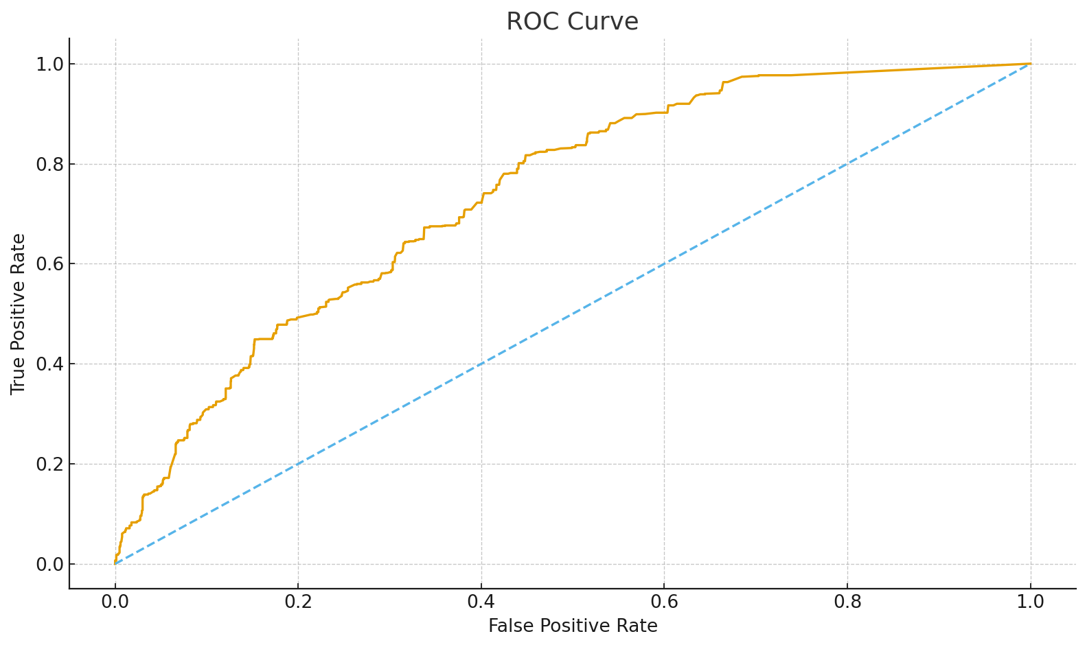
Model 5 – XGB-Cal: ROC Curve
Higher curves indicate better discrimination. The diagonal is chance; AUC summarizes separability.
Slide 44 of 49

Slide 39
Model 5 – XGB-Cal: Precision–Recall Curve
For imbalanced data, PR highlights positive-class performance: precision (purity) vs recall (coverage).
Slide 45 of 49

Slide 40
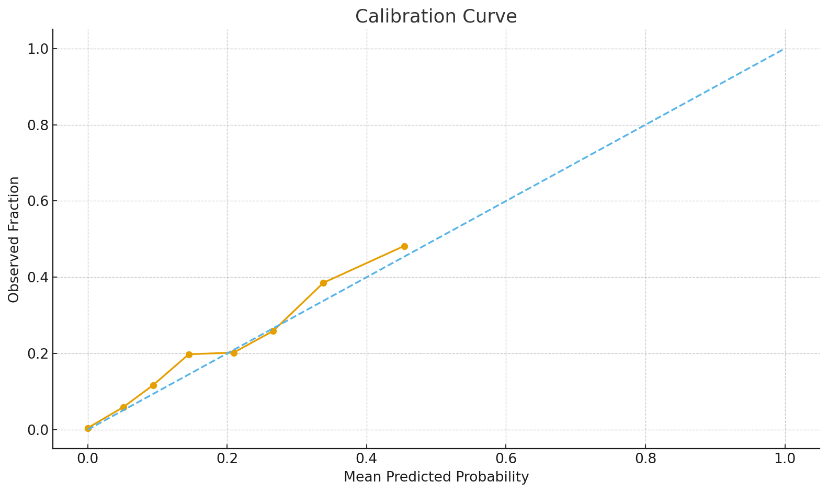
Model 5 – XGB-Cal: Calibration Curve
Points near the diagonal indicate well-calibrated probabilities that match observed outcomes.
Slide 46 of 49

Slide 41
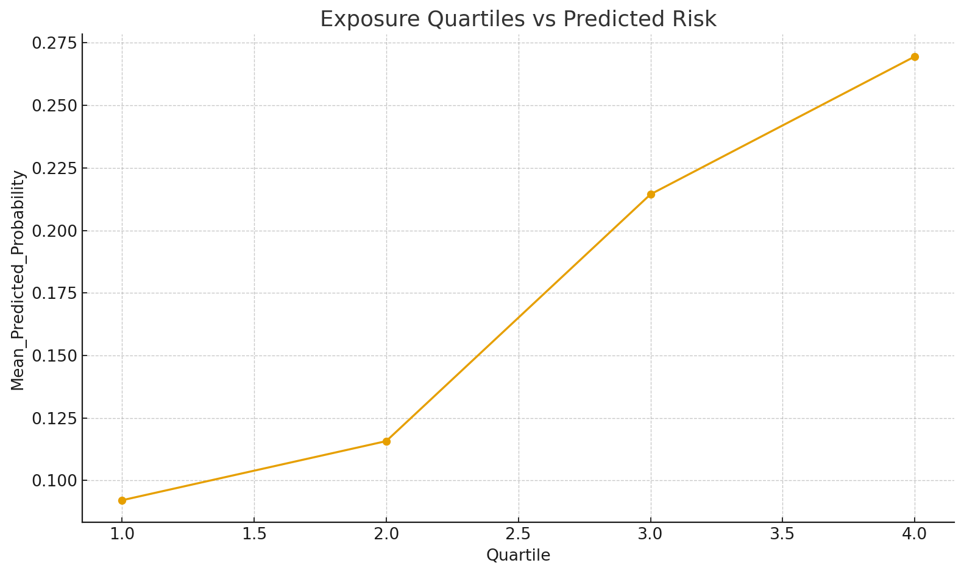
Lead Quartiles vs Risk
A dose–response trend suggests higher exposure corresponds to higher predicted disability risk.
Slide 47 of 49

Slide 42
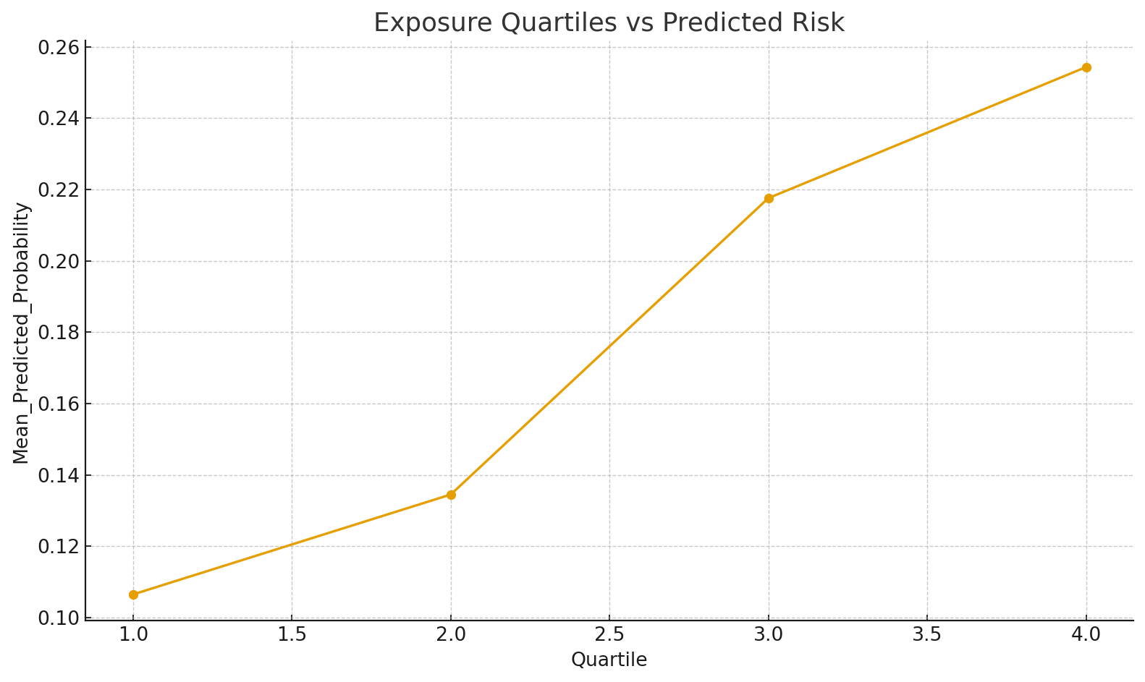
Lead Quartiles vs Risk (XGB-Cal)
A dose–response trend suggests higher exposure corresponds to higher predicted disability risk.
Slide 48 of 49

Slide 43
Executive Summary: Model Comparison
• Logistic: highest AUC (~0.77) with clear interpretability. • Random Forest: strong sensitivity; stable feature rankings. • RF-Cal / XGB-Cal: most reliable probabilities via calibration. • Age, BMI, Cadmium consistently top; Lead shows dose–response.
Slide 49 of 49

